Slide 1
Finding the garden of eden(s)
SAT solver + Conway’s Game of Life

Slide 2
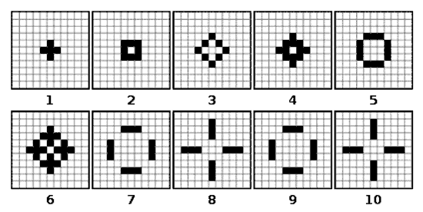
Preliminary
GoL rules, For any cell with N neighbors:
N < 2 : 0 (under population)
N = 2: - (status quo)
N = 3: 1 (birth/reproduction)
N > 3: 0 (over population)

Slide 3
Preliminary Math
Board B = [[0,0,1], [0,0,0], [1,0,0]] or “001000100”
T3b3(B) -> B’
T3b3: non-invertible, ie T3b3^-1(B’) -> 0,1, or many boards
We are interested in finding 0,1 cases..

Slide 4
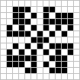
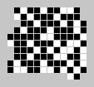
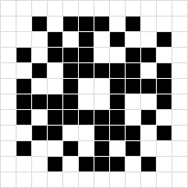

T-1(B’)
0: “Garden of Eden”
1: Single Predecessor
T-1(B’) == B’, identity, aka “Still Life”

Slide 5
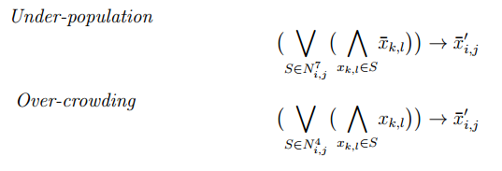
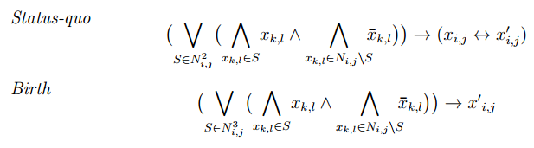
Encoding GoL rules

Slide 6
Encoding GoL rules
Has some subtieties:
Still figuring out

Slide 7
Searching / Enumerating
Eliminate known predecessors, parallelize SAT checking, ad-hoc HPC
TODO

